Slide 1

Smart Budget Tracker
Developed By
Team NAK

Slide 2

Overview
Android app which keeps track of user's spending .
Helps in categorizing and analyzing user spending trend.
Alerts user when budget limit is near.

Slide 3
What it does…
Authenticates user
Collects user data
Stores data in the server
Data is analyzed
Report Generated

Slide 4
Flow diagram

Slide 5
System Modules
Design and Development of Database schema
Authentication
Development of Tab layout and Tabs
Home tab with backend server coding
Categories tab with backend server coding
Expense tab with backend server coding
Goal tab with backend server coding.
History tab with its backend server coding.

Slide 6
Database Schema

Slide 7
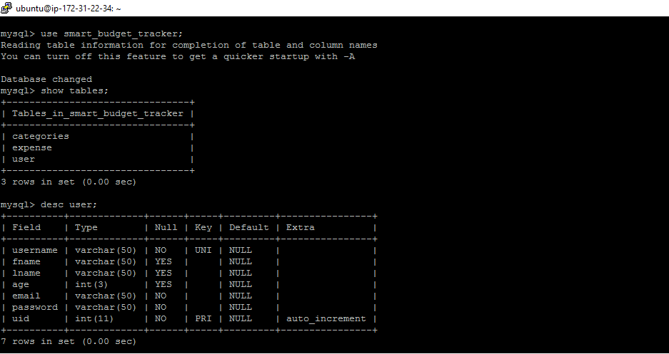
Database and Tables

Slide 8
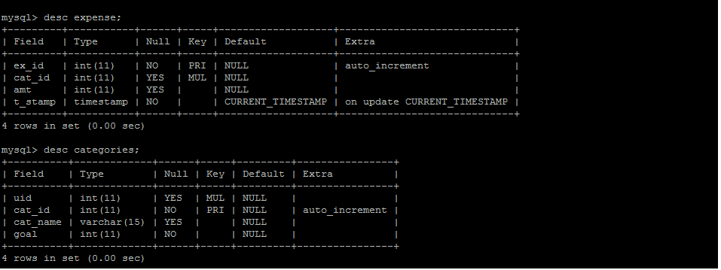
Continues..

Slide 9

Remote Method Invocation

Slide 10
Advantages of using AWS
Reusability
Supports multiple type of devices.
Secure remote data storage.

Slide 11
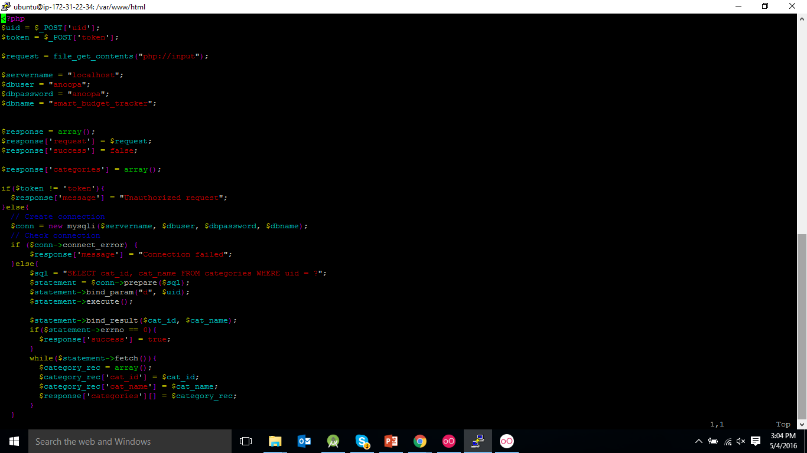
Sample PHP request

Slide 12
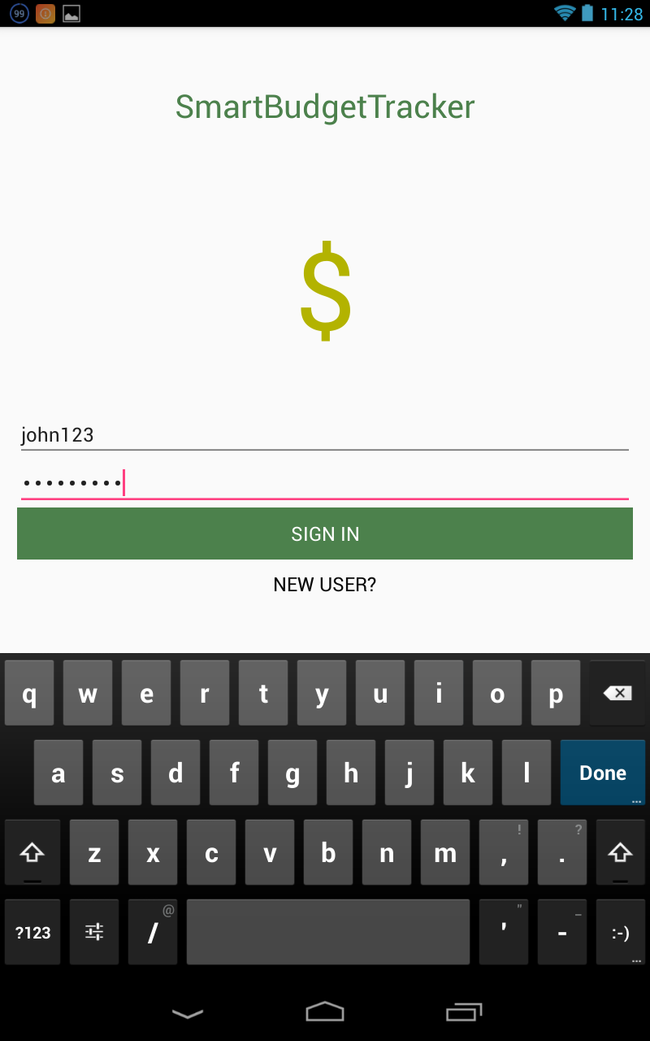
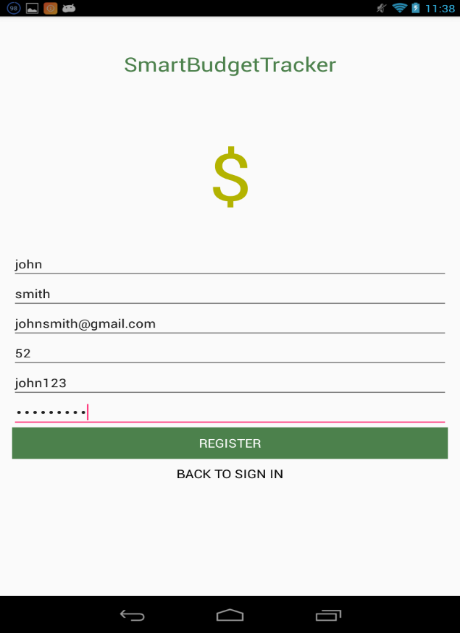
Authentication(Login and Register)

Slide 13
Tab
Home
Categories
Expenses
History
Goal

Slide 14
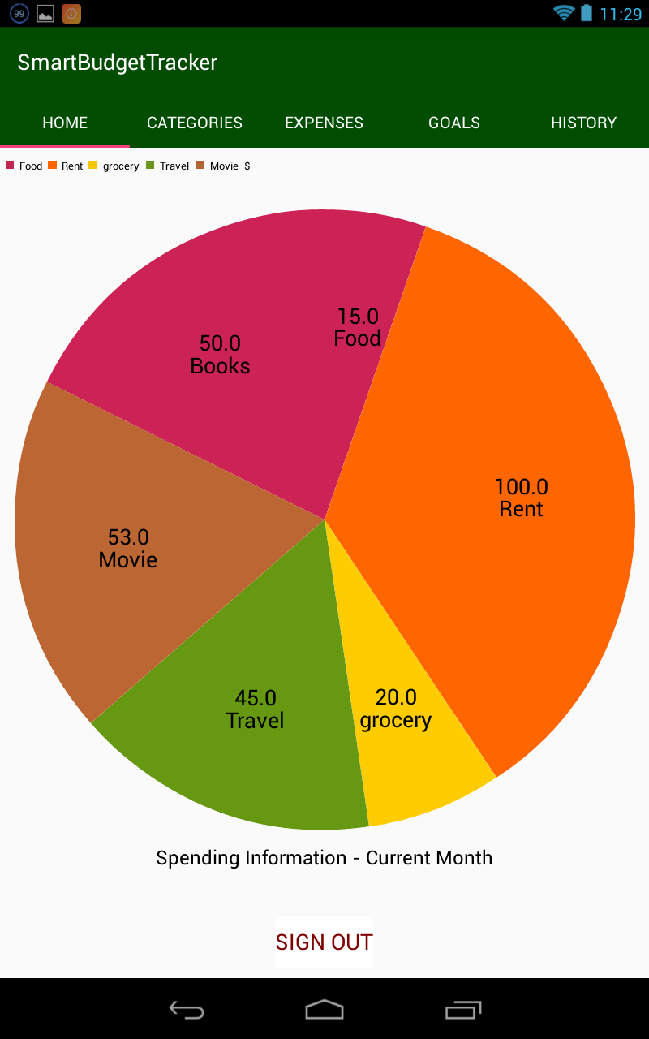
Home Tab
This displays the current status of user’s spending in the form of pie chart.
User can sign out coming back to home tab.

Slide 15
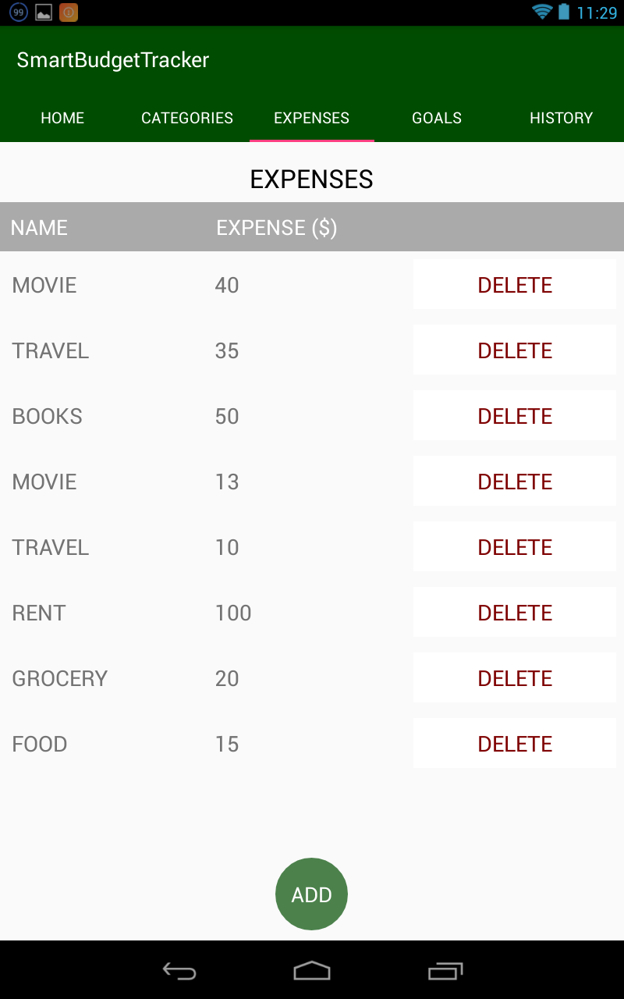
Expense Tab
This tab shows the list of expenses that the user entered in that corresponding month.
This also provides the facility to add and delete expenses if needed which gets automatically updated and displayed.

Slide 16
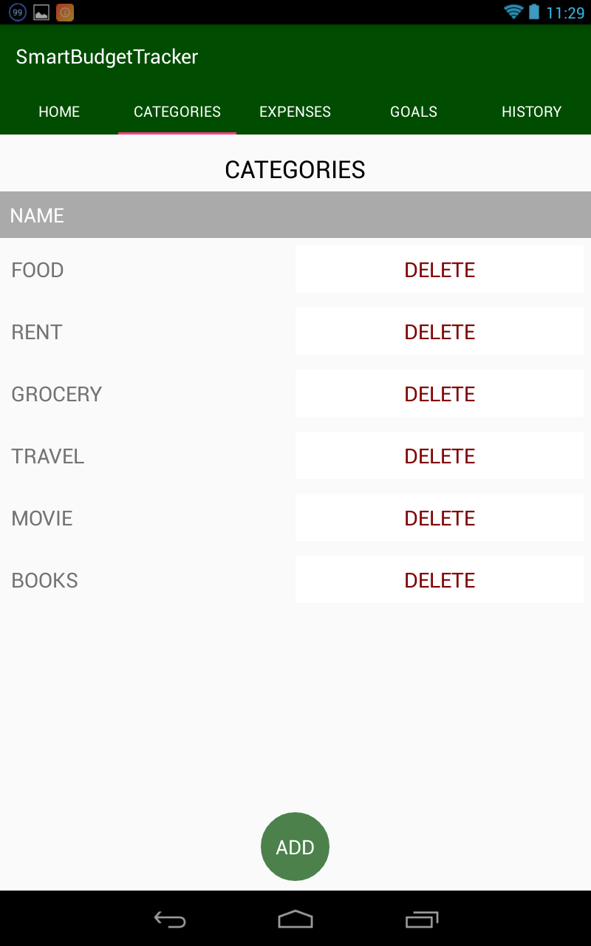
Categories Tab
This tab shows the list of categories that the user has currently added
This also provides the facility to add and delete categories if needed which gets automatically updated and displayed.

Slide 17
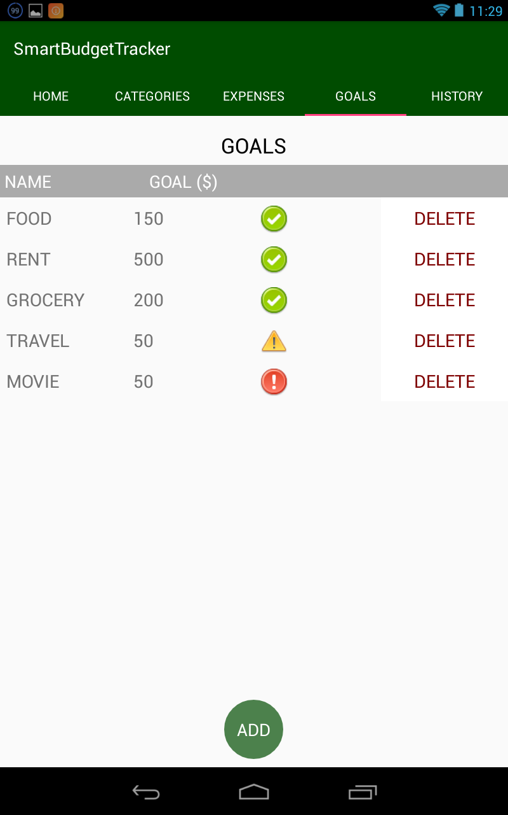
Goal Tab
This tab shows the list of goals set on each category that the user has currently added
This also provides the facility to add and delete goals if needed which gets automatically updated and displayed.
This also shows the current status of each spending
If goal is exceeded it shows red alert across that category
If user is almost near 80% goal caution signal is shown
Else it will show a green signal

Slide 18
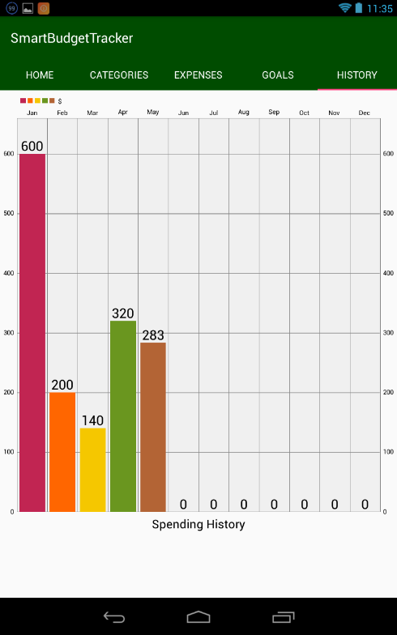
History Tab
This tab shows a bar graph representing the spending history of user
Total spending of current year is shown.

